Slide 1
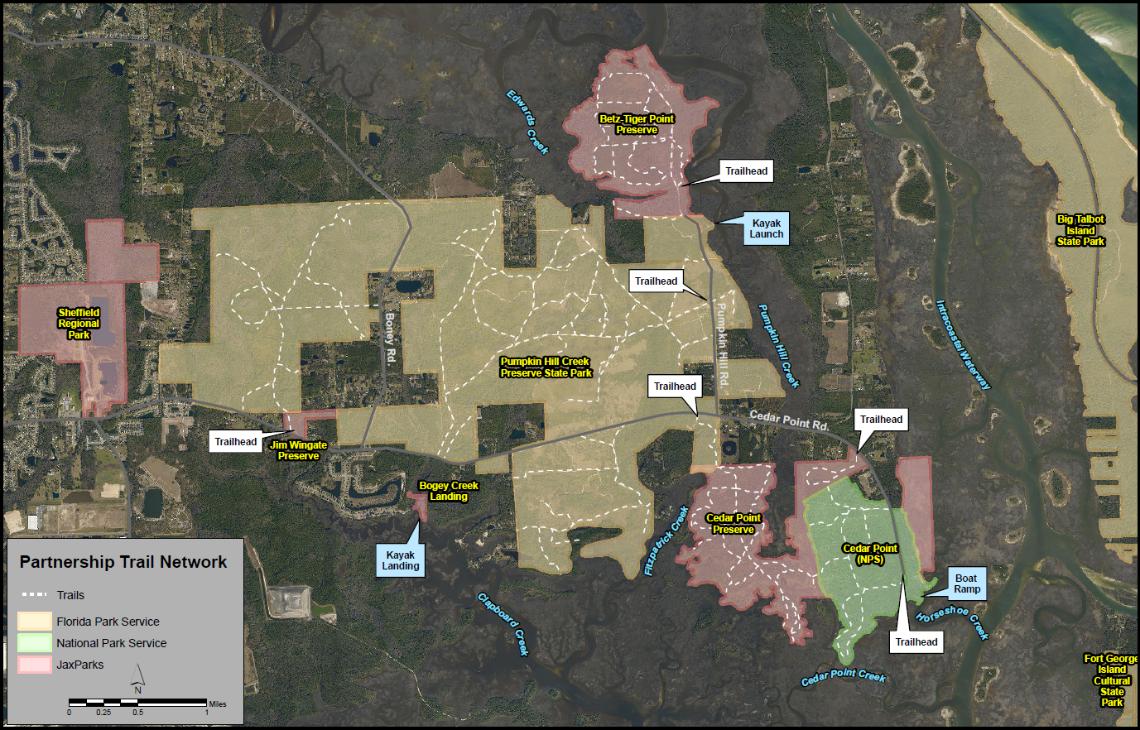
Pumpkin Hill/Cedar Point/Betz-Tiger Point: Trail Network
Bridge

Slide 2
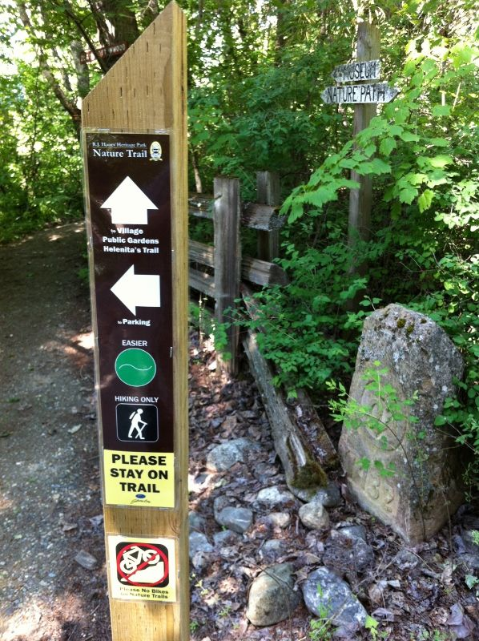
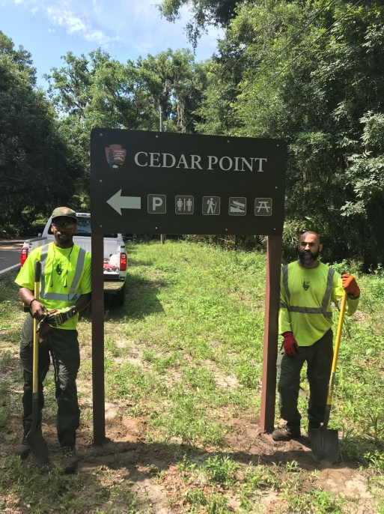
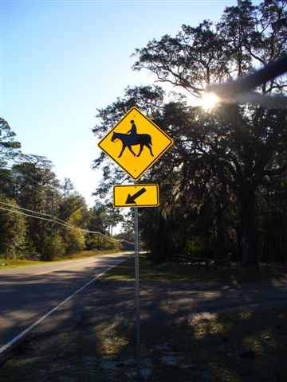
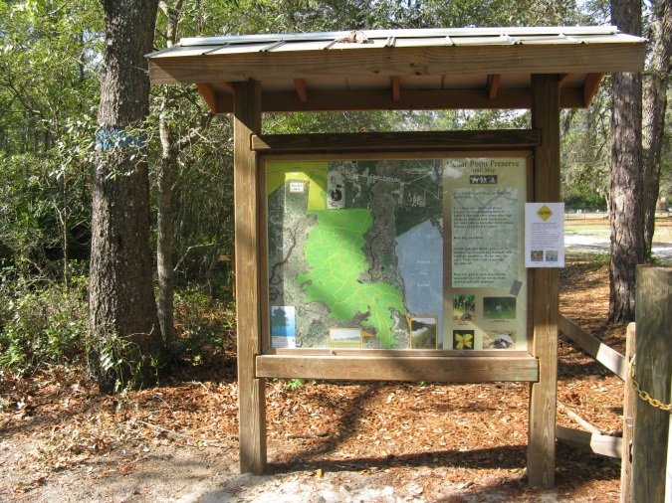
Creating a Connected & Seamless Experience
Branding for Area Trails
New On-Street Directional Signs
New & Improved Trailheads w/Orientation Kiosks
Consistent Trail Signage/Markings
Safe Road Crossings
235’ Trail Bridge

Slide 3
